Slide 1
Intrusion Detection, Access Control
and Other Security Tools
1

Slide 2
Intrusion Terminology
• Intrusion: attack on information where malicious
perpetrator tries to break into, disrupt system
Intrusion detection: includes procedures and systems
created and operated to detect system intrusions
Intrusion reaction: covers actions organization takes
upon detecting intrusion
• Intrusion correction activities: restore normal operations
Intrusion prevention: actions that try to deter intrusions proactively
2

Slide 3
Intrusion Detection Systems (IDSs)
• Detects “configuration” violation, sounds alarm
• IDSs inform admins of trouble via e-mail, pagers
• Can configure systems to notify external security
org.
of
“break-in”
3

Slide 4
IDS Terminology
• Alert, alarm: self-explanatory
• False negative: IDS fails to detect actual attack
• False positive: Attack alert when none occurred
• Confidence value: Estimate of attack probability
• Alarm filtering: self-explanatory
4

Slide 5
IDS Classification
Methods
① IDS detection methods:
– Signature-based (sig IDS)
– Statistical anomaly-based (stat
② IDS operation:
IDS)
– Network-based intrusion detection syst. (NIDS)
– Host-based IDS (HIDS)
– Application-based systems (AppIDS)
5

Slide 6
Classification (1): Sig. IDS
• Find network, host traffic patterns that match
known signatures
• Advantage: Many attacks have distinct signatures
• Disadvantages:
– IDS’s signature database must be updated to keep
pace with new attacks
– Malicious code authors intentionally use tricks to fool
these IDSs
6

Slide 7
Classification (1): Stat. IDS
Statistical anomaly-based IDS sample network activity, compare to “known normal” traffic
IDS sounds alarm when activity is outside baseline parameters
• Advantage: IDS can detect new types of attacks
• Disadvantages:
– Requires more overhead, compute power than
signature-based IDSs
– May generate many false positives
7

Slide 8
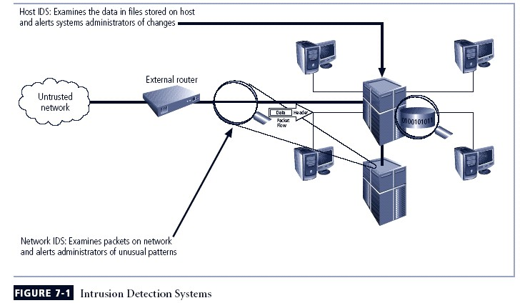
8

Slide 9
Classification (2): NIDS
Resides on computer or appliance connected to segment of an organization’s network; looks
for signs of attacks
• When examining packets, a NIDS looks for
attack patterns
• Installed at specific place in the network where
it can watch traffic going into and out of
particular network segment
9

Slide 10
NIDS Signature Matching
▪ NIDSs look for attack patterns for detection
▪ Accomplished via certain implementation of
TCP/IP stack:
– Protocol stack verification: look for invalid packets
– App. protocol verification: look at
higher-order
protocols
for
unexpected
behavior
or
improper
use
10

Slide 11
NIDS Advantages, Disadvantages
Advantages
Org. can monitor large
network with few devices
Passive; deployment
minimally disrupts operations
• Less susceptible to attack;
attackers may not detect them
Disadvantages
•
Can be overwhelmed by
volume of network traffic
Need to monitor all traffic
Cannot analyze encrypted
network packets
Cannot determine if attack
was successful
Cannot detect some attacks
(e.g., fragmented packets)
•
•
•
•
11

Slide 12
Classification (2): HIDS
• HIDS runs on a particular computer, monitors activity
only on that system
Benchmarks, monitors key system files; detects when intruders’ file I/O
• HIDSs work on principle of configuration management
Unlike NIDSs, HIDSs can be installed to access info. that’s encrypted in transit over network
12

Slide 13
HIDS Advantages, Disadvantages
Advantages
▪ Detect local events, attacks on
host systems that NIDSs may not
▪ Can view encrypted traffic (as it
has been decrypted on system)
▪ HIDSs unaffected by switched
network protocols
▪ Can detect inconsistencies in
apps, programs by examining
audit logs
Disadvantages
•
•
Harder to manage than NIDSs
Vulnerable to attacks against host
operating system, HIDS
Cannot detect scans of multiple
hosts, non-network devices
HIDSs potential targets for denial-
of-service (DoS) attack
May use lots of disk space
Possible large compute
performance overhead on host
systems
•
•
•
•
13

Slide 14
Application-Based IDS
Application-based IDS (AppIDS) looks at apps for abnormal events
• AppIDS may be configured to intercept requests:
– File System
– Network
– Configuration
– Process’s Virtual Memory Address Space
14

Slide 15
Advantages and Disadvantages of AppIDSs
▪ Advantages
– Aware of specific users; can observe interaction between apps and users
– Functions with encrypted incoming data
▪ Disadvantages
– More susceptible to attack
– Less capable of detecting software tampering
– May be fooled by forms of spoofing
15

Slide 16
Selecting IDS Approaches and Products
• Technical and policy considerations
– What is your systems environment?
– What are your security goals?
– What is your existing security policy?
• Organizational requirements and constraints
– What requirements are given from outside the org.?
– What are your org’s resource constraints? ($$$)
16

Slide 17
IDS Control Strategies
An IDS can be implemented via one of three basic control strategies
– Centralized: all IDS control functions are implemented and managed in a central location
– Fully distributed: all control functions are applied at the
physical location of each IDS component
– Partially distributed: combines the two; while individual agents can still analyze and respond to local threats, they report to a hierarchical central facility to enable organization to detect widespread attacks
17

Slide 18
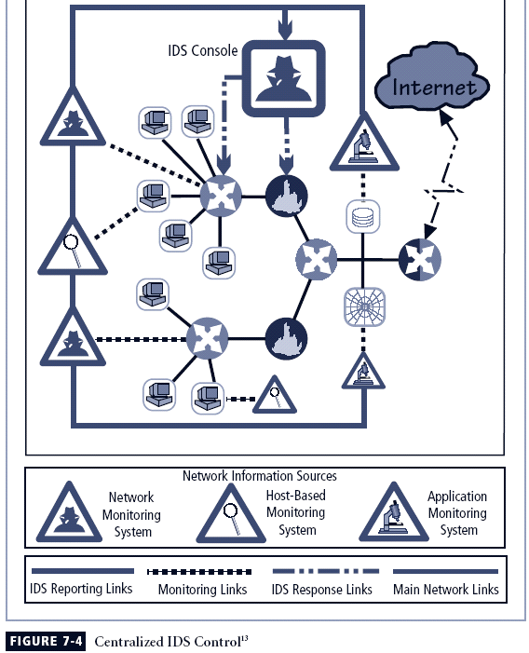
Centralized
IDS
Control
(Fig.
7-4)
18

Slide 19
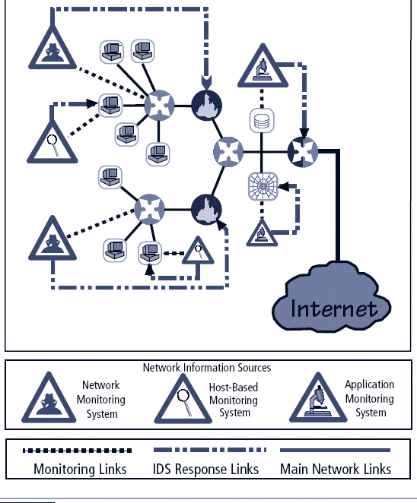
Fully
Distributed
IDS
Control
(Fig.
7-5)
19

Slide 20
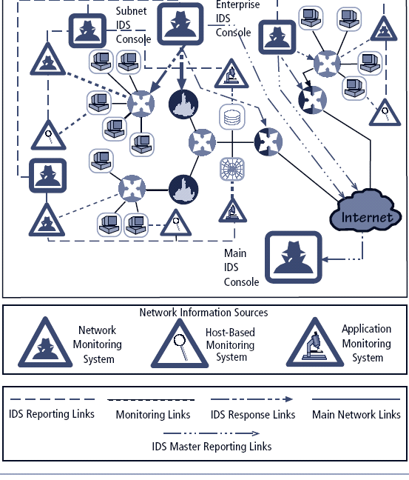
Partially
Distributed
IDS
Control
(Fig.
7-6)
20

Slide 21
IDS
Deployment Overview
• IDS system placement can be a “black art”
– Similar to ”what type of IDS should be use?” question
• Need to balance organization’s security needs
with budget
• We can use NIDS and HIDS in tandem to cover
both individual systems that connect to an org’s
networks and the networks themselves
21

Slide 22
Deploying NIDSs (1)
• NIST recommends four locations for NIDSs:
– Location 1: behind each external firewall, in the
network DMZ
– Location 2: outside an external firewall
– Location 3: on major network backbones
– Location 4: on critical subnets
22

Slide 23
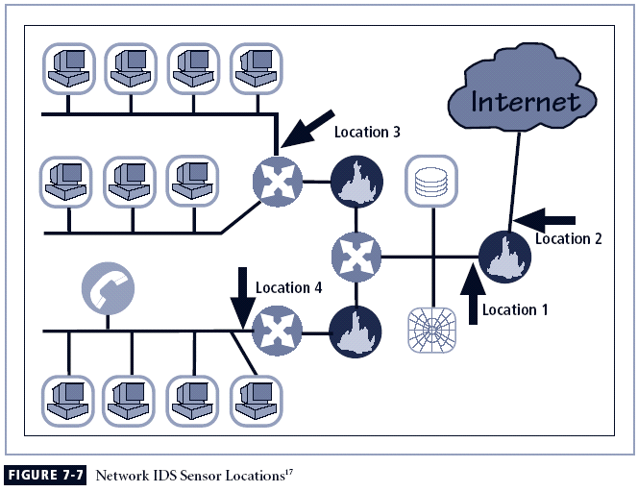
Deploying
NIDSs
(2)
(Fig.
7-7)
23

Slide 24
Deploying HIDS
• Setting up HIDSs: tedious, time-consuming (?)
• Steps:
– First: install HIDSs on most critical systems
– Next: install HIDSs on all systems or until
organization
reaches
tolerable
degree
of
coverage
24

Slide 25
Measuring Effectiveness of IDSs
• IDSs are evaluated using two dominant metrics:
– # of attacks detected in a known collection of probes
– Network bandwidth at which IDSs fail
Example: At 1 Gbits/sec, IDS detected 95% of
directed attacks against it
• Many vendors provide test suites for verification
• Example test suites:
– Record, retransmit real packet trace from virus/worm
– Perform same for malformed packets (e.g., SYN flood)
– Launch
25

Slide 26
Honeypots, Honeynets, and Padded Cell
Systems
• Honeypots: decoy systems designed to lure potential attackers
away from critical systems
• Design goals:
– Divert attacker from accessing critical systems
– Gather information about attacker’s activity
– Encourage attacker to linger so admins can document event, respond
• Honeynets: collection of honeypots connected in a subnet
• Padded cell: honeypot protected in order to hinder compromise
– Typically works in tandem with traditional IDS
– When IDS detects attackers, it transfers them to “special
environment” where they cannot cause harm (hence the name)
26

Slide 27
Honeypots: Advantages and Disadvantages
Advantages
Disadvantages
•
Diverts attackers to targets they can’t damage
Admins have time to determine response
Honeypots can monitor
attackers’ actions; attack
logs can help improve
system security
Honeypots may catch insiders snooping around network
•
Legal implications are not
well defined
Honeypots’ effectiveness as security tech is unclear Expert attacker detecting
honeypot may get angry,
launch worse attack against org.
Admins, security managers
need expertise to use
honeypots
•
•
•
•
•
•
27

Slide 28
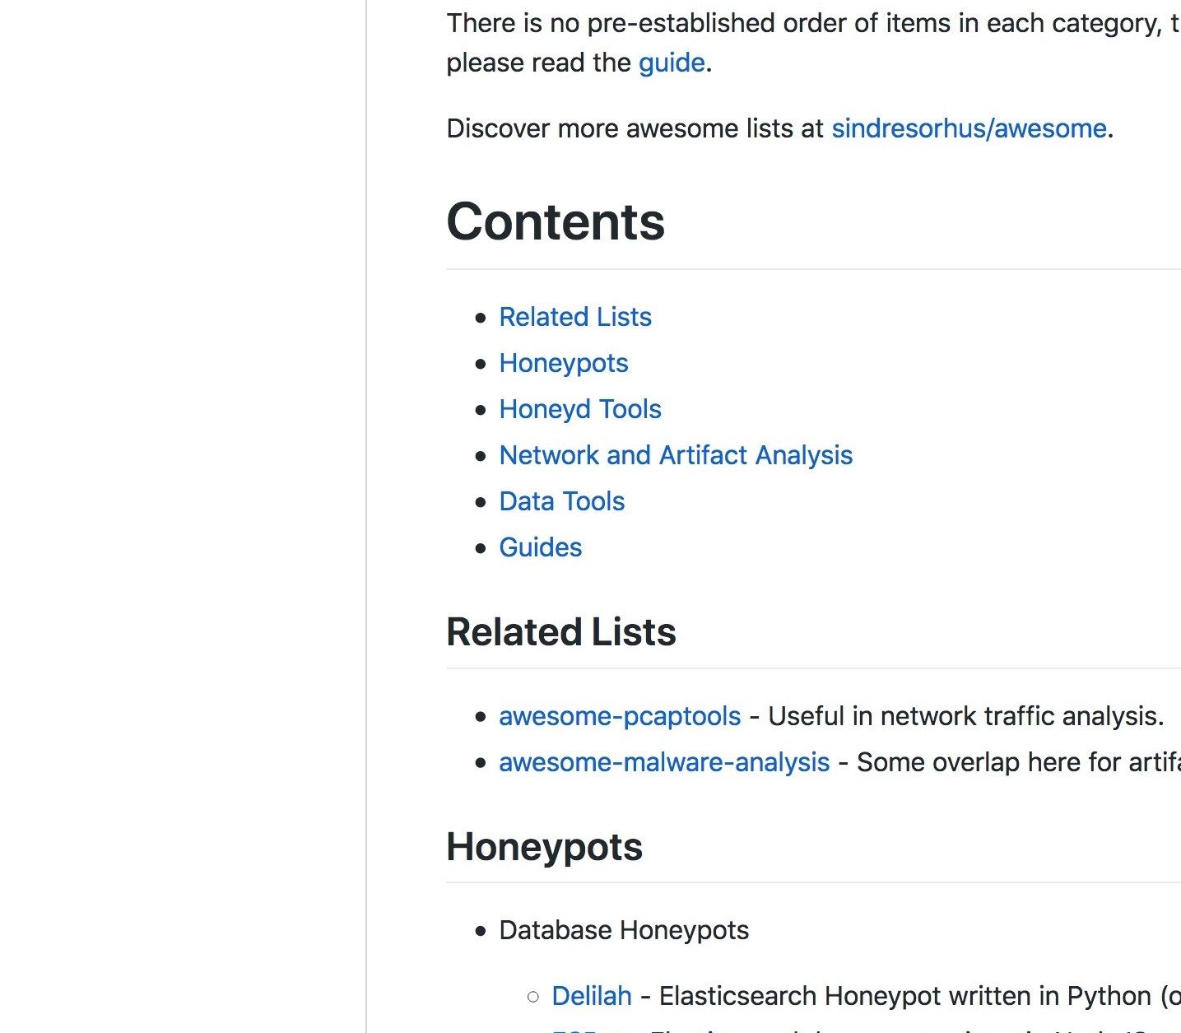
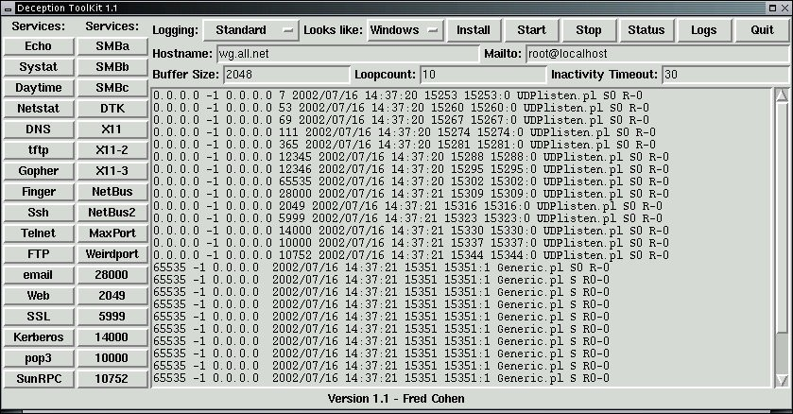
Honeypot
Examples
Sources: Fred Cohen & Associates (http://all.net/WG/index.html);
https://github.com/paralax/awesome-honeypots/
28

Slide 29
Trap and Trace Systems
• Various techniques that detect intrusion, trace it to origin
• “Trap” consists of honeypot/padded cell, alarm
• Legal drawbacks to trap and trace:
Enticement: attracts attacker to system by placing tantalizing info. in certain places
– Entrapment: lures person into committing crime for conviction purpose
– Enticement is legal/ethical; entrapment is not
More info: D.J. Gottfried, “Avoiding the Entrapment Defense in a Post-9/11 World,” FBI Law Enforcement Bulletin,
1 Jan. 2012, https://leb.fbi.gov/articles/legal-digest/legal-
digest-avoiding-the-entrapment-defense-in-a-post-911-world.
29

Slide 30
Scanning and Analysis Tools (1)
Often used to collect information that attacker would need to launch successful attack
Attack protocol: sequence of attacker’s steps to attack target system/network
• Footprinting: determining what hostnames, IP
addresses a target org. owns
Fingerprinting: systematic survey of resources
found in footprinting stage
– Useful for discovering weaknesses in org.’s
network or systems
30

Slide 31
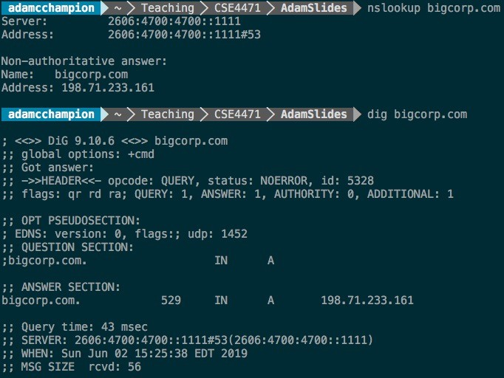

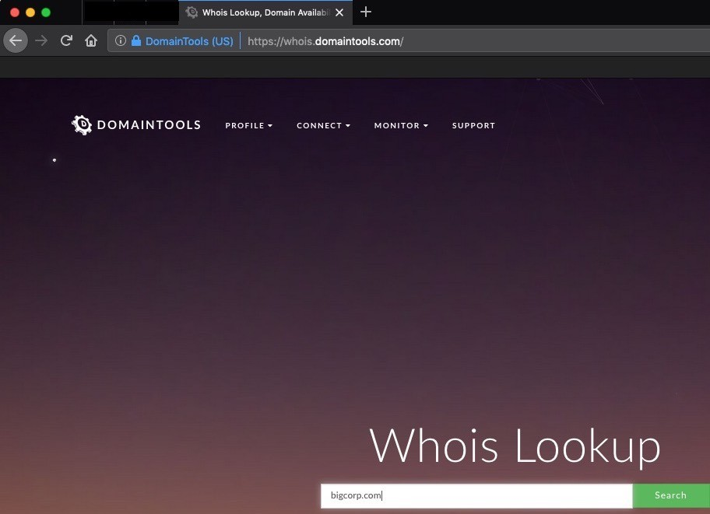
Scanning and Analysis
• Hostname queries: nslookup, dig
(Un*x)
• IP address ownership:
– whois, https://whois.domaintools.com/
• Internet search queries:
“Proprietary”, “Confidential”
• Also: https://tools.wordtothewise.com/
Tools
(2)
31
Sources: Self-taken screenshots;
https://whois.domaintools.com

Slide 32
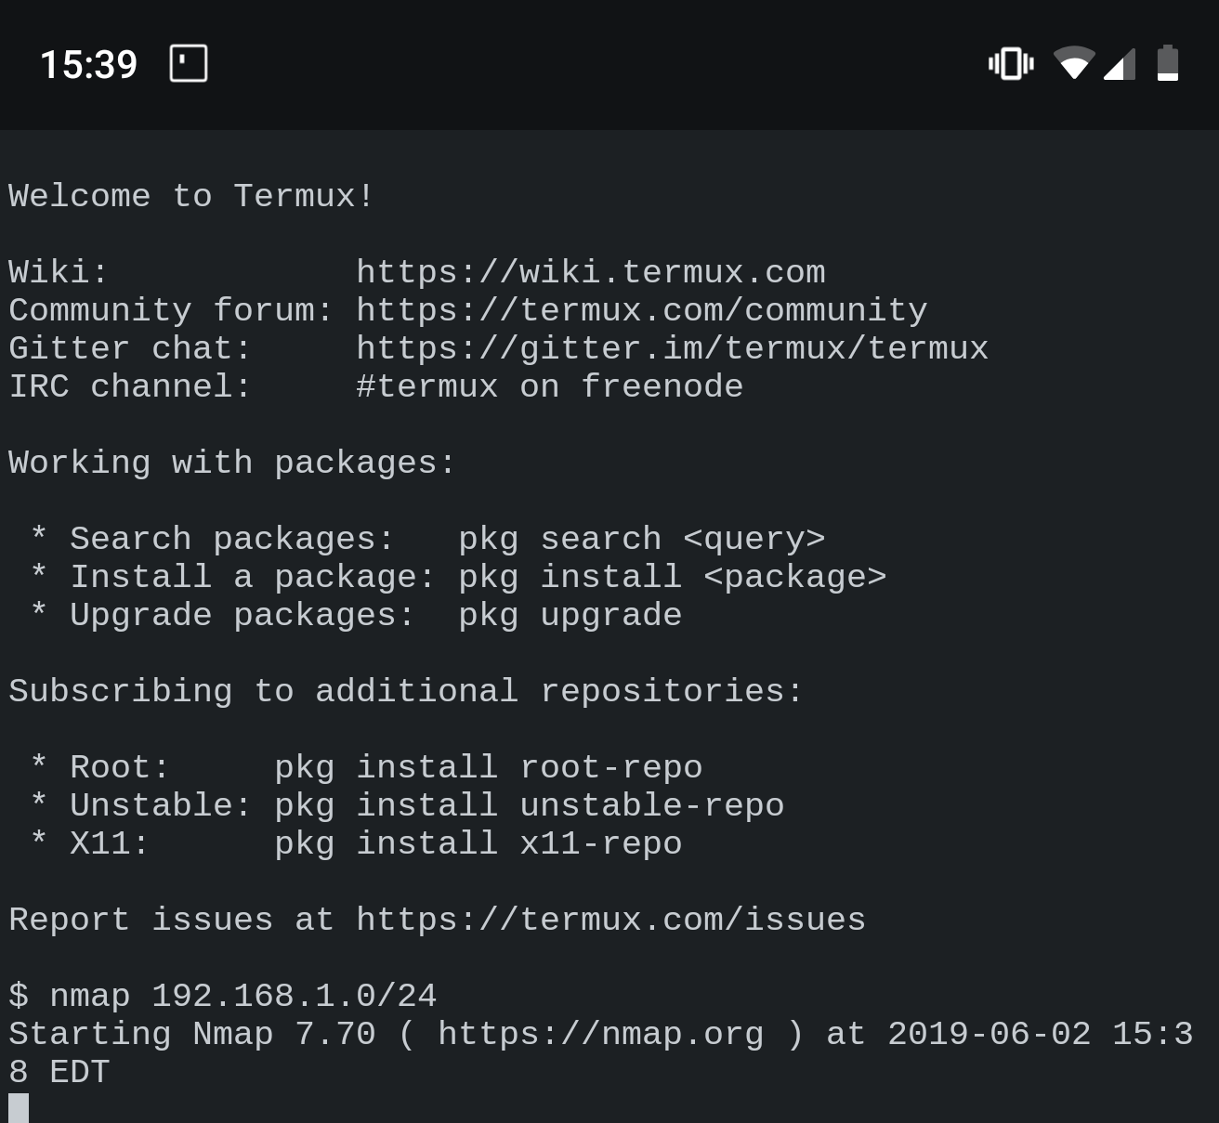
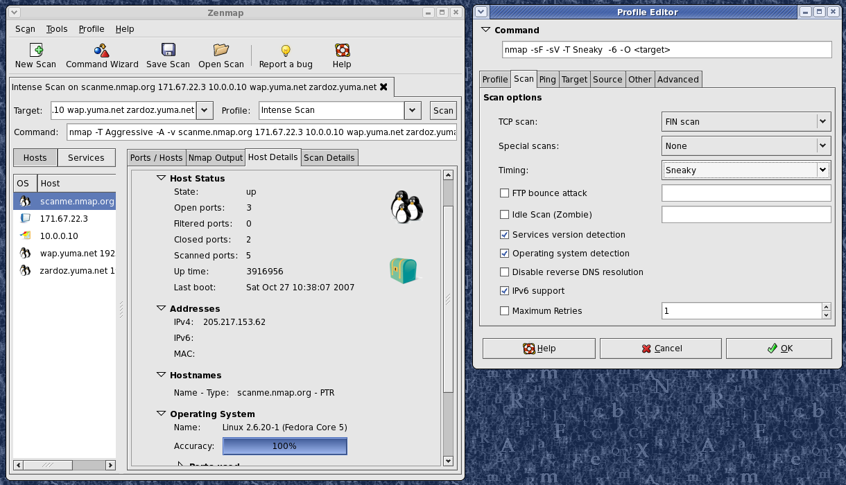
Port Scanners
Tools used by attackers, defenders to identify computers on network (plus other info.)
• Can scan for certain computers, protocols, resources
(or generic scans)
• Example: nmap (https://nmap.org/)
32
Sources: https://nmap.org;
self-taken screenshot

Slide 33
Firewall Analysis Tools
• Several tools automate discovery of firewall
rules, assist admins in rule analysis
Admins who are wary of using same tools that attackers use should remember:
– User intent dictates how gathered info. is used
– Need to understand ways to attack computer/network in order to defend it!
• Example: Nessus
(https://www.tenable.com/products/nessus)
33

Slide 34
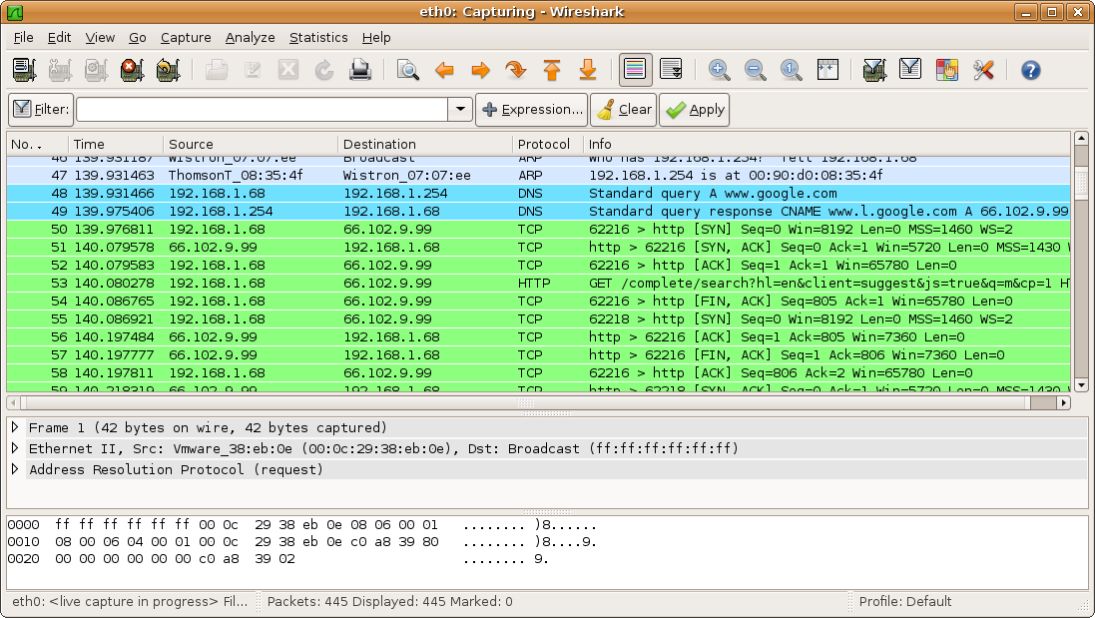
Packet Sniffers
• Tool that gathers network packets, analyzes them
Can provide network admin with info. to solve networking issues (or attacker eavesdropping)
For legal use: admin must be on org.-owned network and have consent from net. owners
• Example tool: Wireshark
Source: Wikipedia
(user SF007)
34

Slide 35
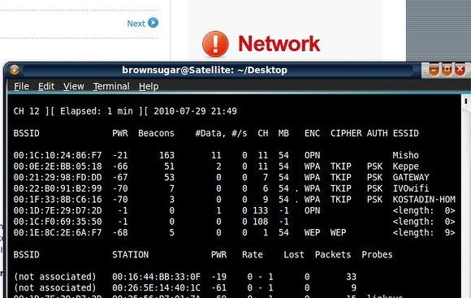
Wireless Security
Tools
• Organization needs to
consider wireless security in
tandem with its deployed
wireless networks
Toolkits can sniff wireless
traffic, scan hosts, and
assess network privacy
• Don’t use WEP!
• Example tools:
Source: Flickr (user: raynedata)
–
–
Wireshark
aircrack-ng
35

Slide 36
Access Control Devices
• Access control: authenticates, authorizes users
– Authentication: validate a person’s identity
– Authorization: specify what the person can do with
computers, networks
– Recommended: use ≥ two types of auth. technology
• Four main ways to authenticate person:
– What a person knows (e.g., password);
– What a person has (e.g., Duo Mobile app code);
– Who a person is (e.g., fingerprint);
– What a supplicant produces (e.g., work badge)
36

Slide 37
Summary
Intrusion detection system (IDS) detects configuration violation and sounds alarm
• Network-based IDS (NIDS) vs. host-based IDS
(HIDS)
• Complex selection of IDS products that fit an
organization’s needs!
• Honeypots are decoy systems; two variations are
honeynets and padded cell systems
37

Slide 38
Summary
Scanning and analysis tools are used to pinpoint vulnerabilities in systems, holes in security components, and unsecured aspects network
of
• Authentication is validation of prospective
user’s (supplicant’s) identity
38

Slide 39
Reference
[1] Class note by Adam C. Champion, Ph.D.

